Slide 1
Randomized Algorithms
Global Minimum Cut Algorithm

Slide 2
The global min cut problem
Input: A connected undirected multigraph G(V, E).
Output: A minimum cardinality subset of edges whose removal makes G disconnected.
a
b
c
d
x

Slide 3
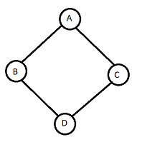
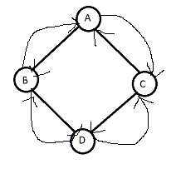
UN DIRECTED GRAPH
MULTI GRAPH

Slide 4
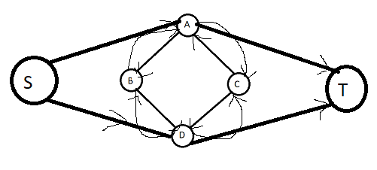
Multi Graph with Source and Sink

Slide 5
Given an undirected graph G = (V, E), we define a cut of G to be a partition of V into two non-empty sets A and B.
Earlier, when we looked at network flows, we worked with the closely related definition of an s-t cut:
there, given a directed graph G = (V, E) with distinguished source and sink nodes s and t, an s-t cut was defined to be a partition of V into sets A and B such that s ∈ A and t ∈ B.
Our definition now is slightly different, since the underlying graph is now undirected and there is no source or sink.

Slide 6
For a cut (A, B) in an undirected graph G, the size of (A, B) is the number of edges with one end in A and the other in B.
A global minimum cut is a cut of minimum size.
The term global here is meant to connote that any cut of the graph is allowed; there is no source or sink.
Thus the global min-cut is a natural “robustness” parameter; it is the smallest number of edges whose deletion disconnects the graph.
We first check that network flow techniques are indeed sufficient to find a global min-cut ?

Slide 7
Designing the Algorithm
we describe the Contraction Algorithm in its simplest form.
This version, while it runs in polynomial time, is not among the most efficient algorithms for global min-cuts.
However, subsequent optimizations to the algorithm have given it a much better running time.

Slide 8
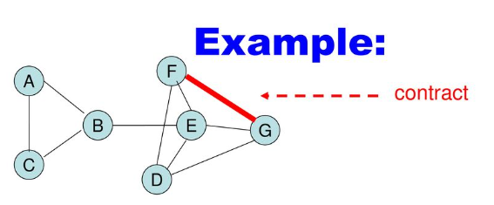

Slide 9
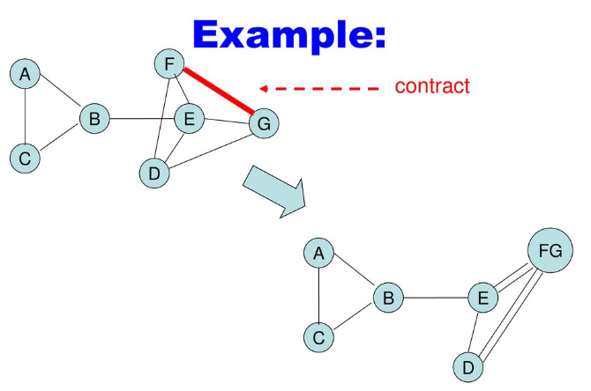

Slide 10
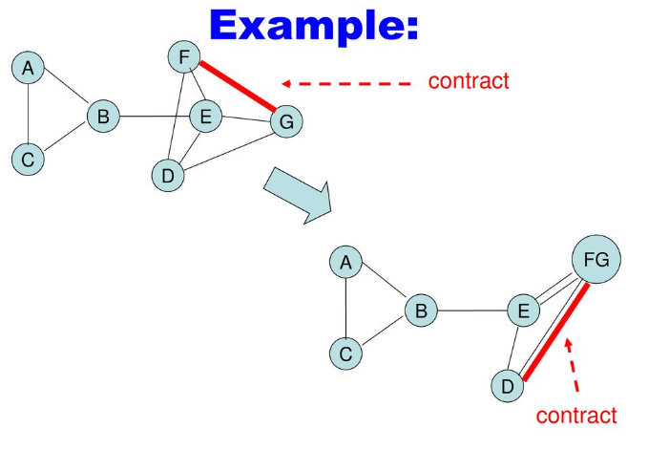

Slide 11
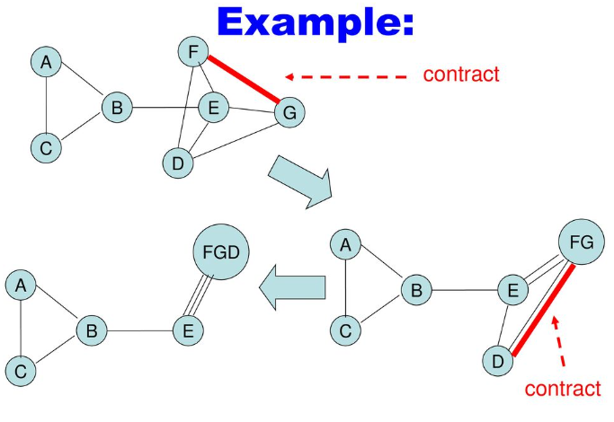

Slide 12
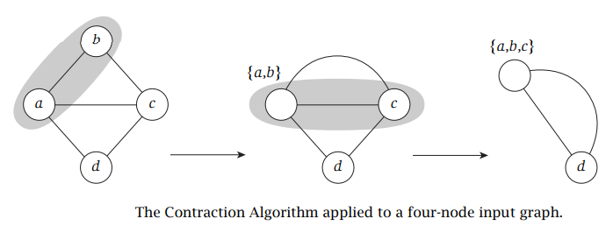
The Contraction Algorithm works with a connected multigraph G = (V, E);
This is an undirected graph that is allowed to have multiple “parallel” edges between the same pair of nodes.
It begins by choosing an edge e = (u, v) of G uniformly at random and contracting it.

Slide 13
This means we produce a new graph G’ in which u and v have been identified into a single new node w;
all other nodes keep their identity. Edges that had one end equal to u and the other equal to v are deleted from G’.
Each other edge e is preserved in G’ , but if one of its ends was equal to u or v, then this end is updated to be equal to the new node w.
Note that, even if G had at most one edge between any two nodes, G’ may end up with parallel edges.

Slide 14
The Contraction Algorithm then continues recursively on G’ , choosing an edge uniformly at random and contracting it.
As these recursive calls proceed, the constituent vertices of G’ should be viewed as supernodes:
Each supernode w corresponds to the subset S(w) ⊆ V that has been “swallowed up” in the contractions that produced w.
The algorithm terminates when it reaches a graph G’ that has only two supernodes v1 and v2 (presumably with a number of parallel edges between them).
Each of these super-nodes vi has a corresponding subset S(vi) ⊆ V consisting of the nodes that have been contracted into it, and these two sets S(v1) and S(v2) form a partition of V.
We output (S(v1), S(v2)) as the cut found by the algorithm.

Slide 15
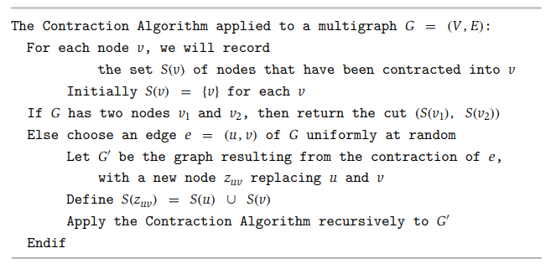

Slide 16
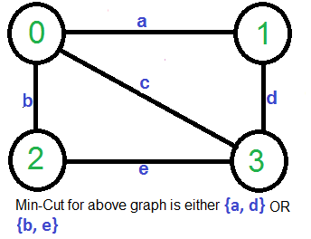
consider the following example,
the smallest cut has 2 edges.

Slide 17
Below Karger’s algorithm can be implemented in O(E) = O(V2) time.
1) Initialize contracted graph CG as copy of original graph
2) While there are more than 2 vertices.
a) Pick a random edge (u, v) in the contracted
graph.
b) Merge (or contract) u and v into a single
vertex (update the contracted graph).
c) Remove self-loops
3) Return cut represented by two vertices.

Slide 18
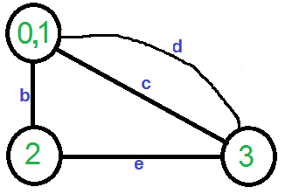
Let us understand above algorithm through the example given.
Let the first randomly picked vertex be ‘a‘ which connects vertices 0 and 1. We remove this edge and contract the graph (combine vertices 0 and 1). We get the following graph.

Slide 19
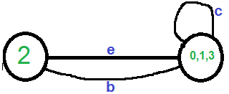

Let the next randomly picked edge be ‘d’. We remove this edge and combine vertices (0,1) and 3.
We need to remove self-loops in the graph. So we remove edge ‘c’
Now graph has two vertices, so we stop. The number of edges in the resultant graph is the cut produced by Karger’s algorithm.

Slide 20
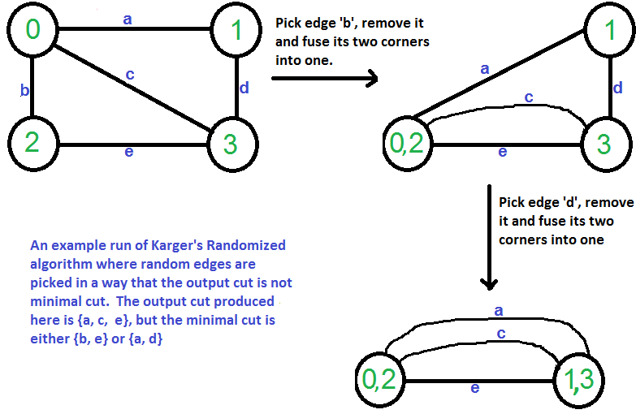
Karger’s algorithm is a Monte Carlo algorithm and cut produced by it may not be minimum. For example, the following diagram shows that a different order of picking random edges produces a min-cut of size 3.

Slide 21
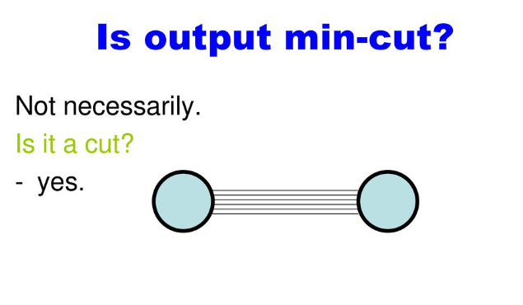

Slide 22
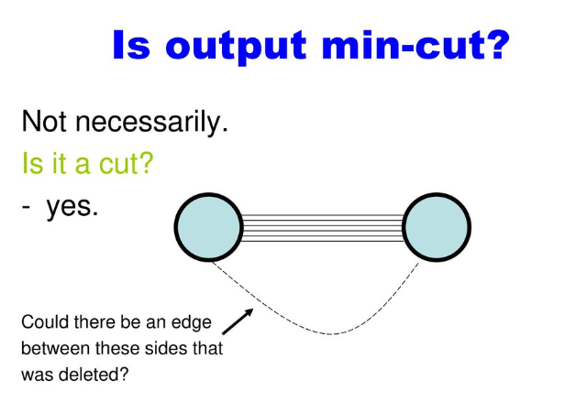

Slide 23
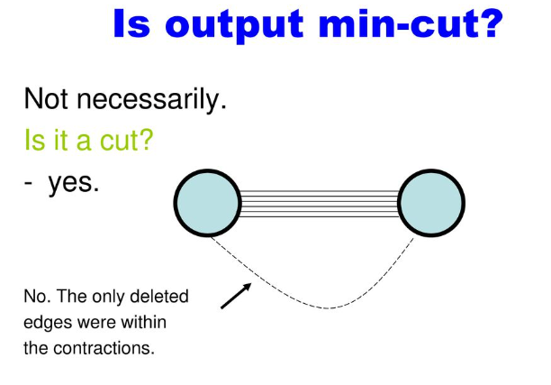

Slide 24
